Slide 1
Connect with friends and the world around you…

Slide 2
Connect with your friends — and other fascinating people.

Slide 4
be together, not the same.

Slide 5
Just do it.
NIKE

Slide 6
Impossible is nothing

Slide 8
Mc Donald’s

Slide 9
KFC
so good!

Slide 10
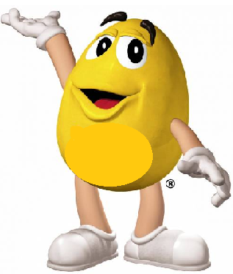
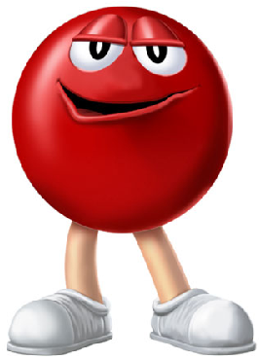
Melts in Your Mouth, Not in Your Hands

Slide 11
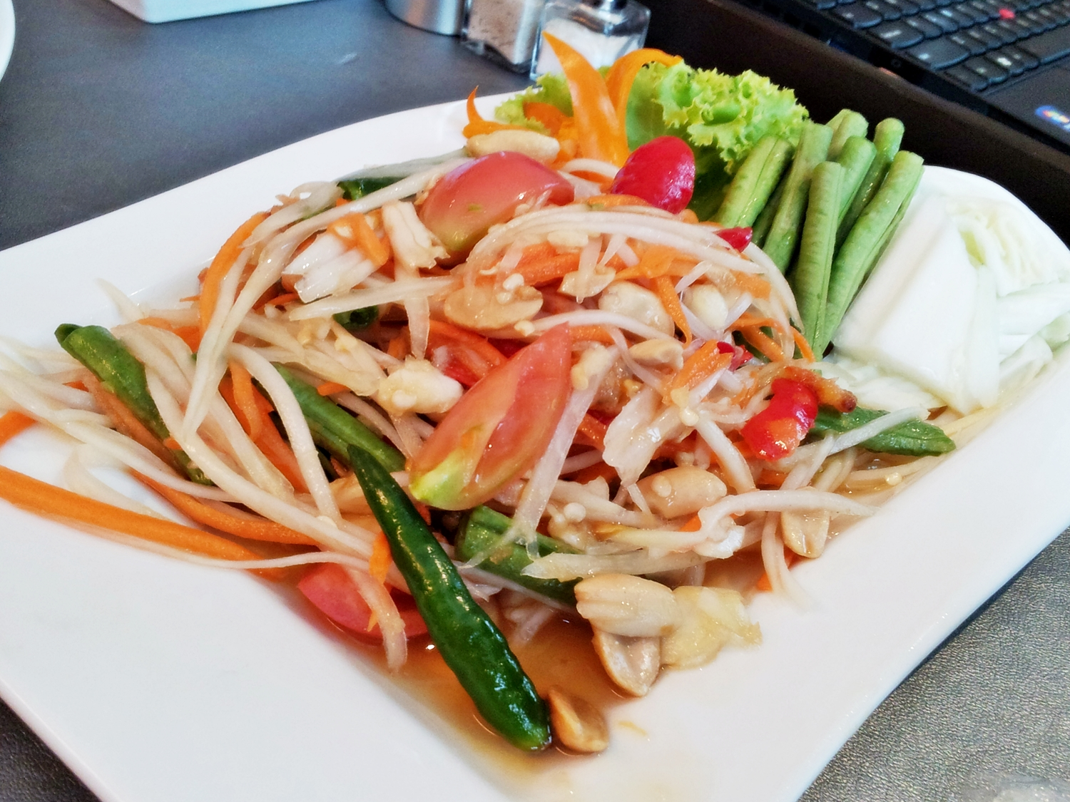
mouth watering… so delicious!!!

